Slide 1
Hardware Fundamentals
Sonu Verma
Sonali Ambulkar
Subhadip Das
Subhra Ghosh
Sushant Kumar
Soumi Khatua
Swarnadeep Das
Notes:
Abhijeet More

Slide 2
INTRODUCTION
Notes:
Abhijeet More

Slide 3
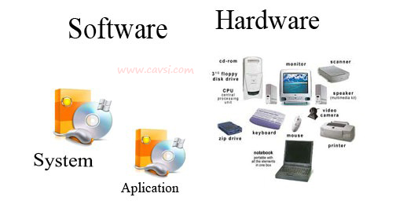
INTRODUCTION
A computer is an electronic machine that manipulates data according to a set of instructions.
Software:- The instruction and data are called software.
Hardware:- The physical components which works according to the instructions are called hardware.

Slide 4
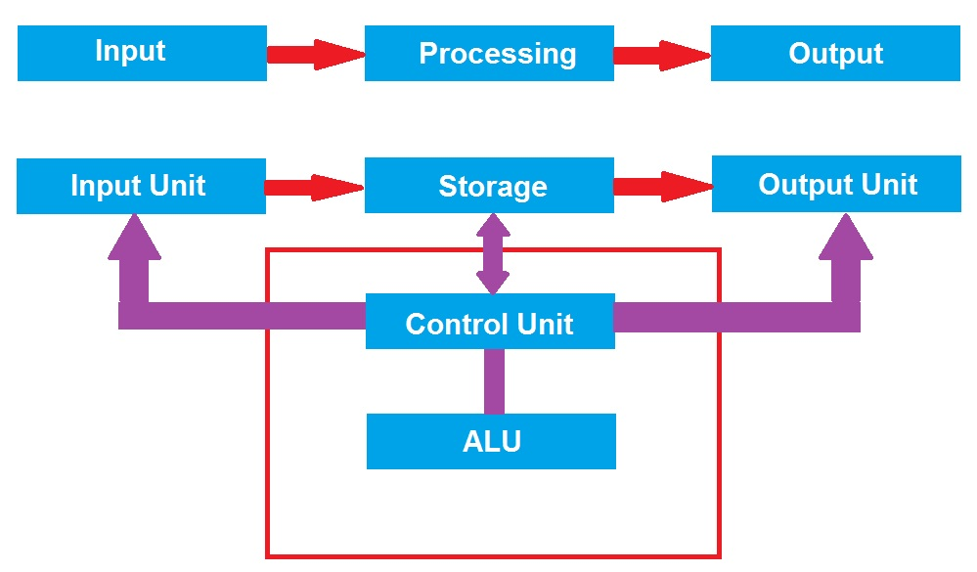
INTRODUCTION
Key components of computer.

Slide 5
INPUT DEVICES
Notes:
Abhijeet More

Slide 6
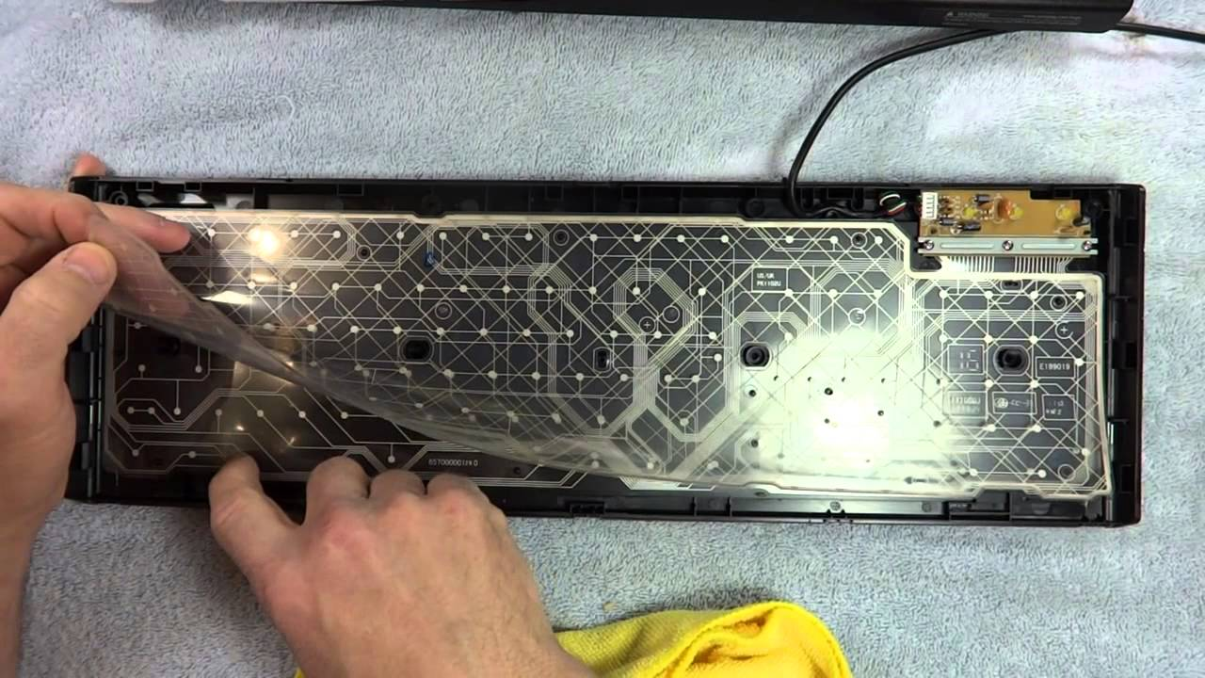
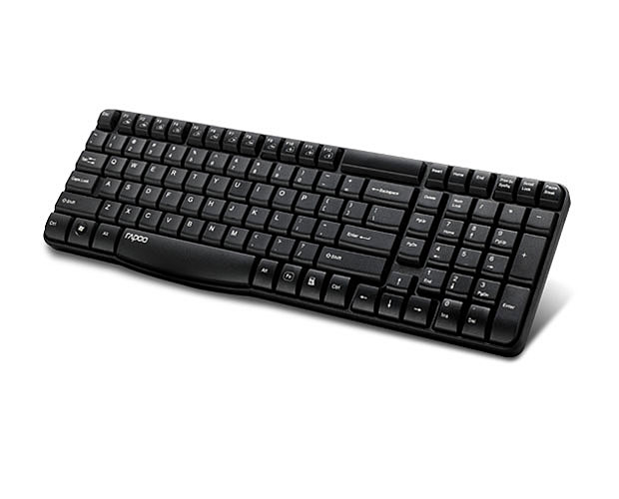
INPUT DEVICES
Keyboard:-A computer keyboard is defined as the set of typewriter-like keys that enables you to enter data into a computer.

Slide 7
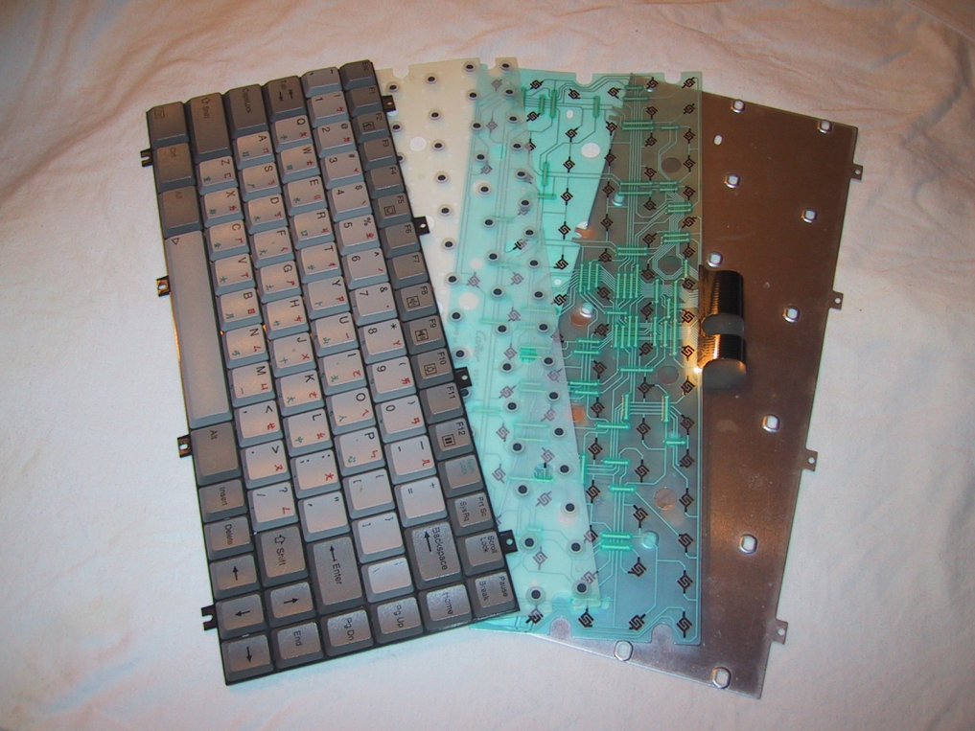
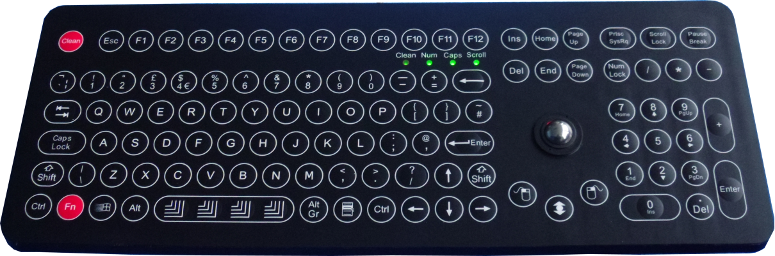
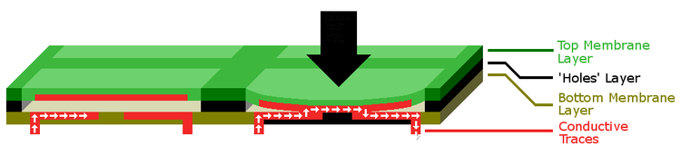
INPUT DEVICES.
Different types of keyboard
Mechanical keyboard
Membrane keyboard

Slide 8
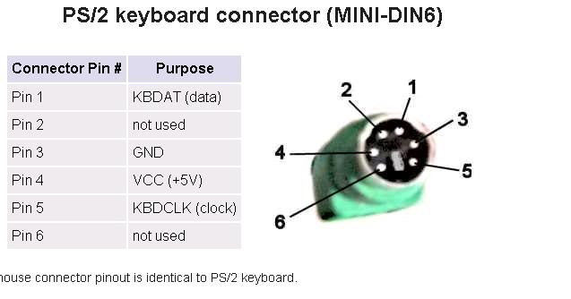
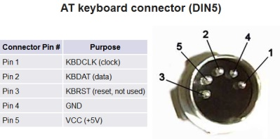
INPUT DEVICES
Keyboard connector and details.

Slide 9
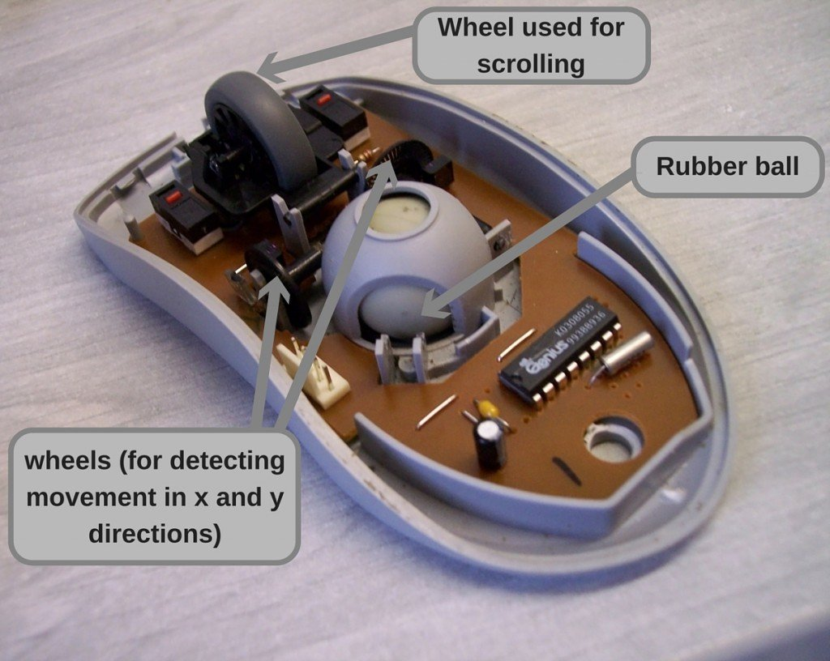
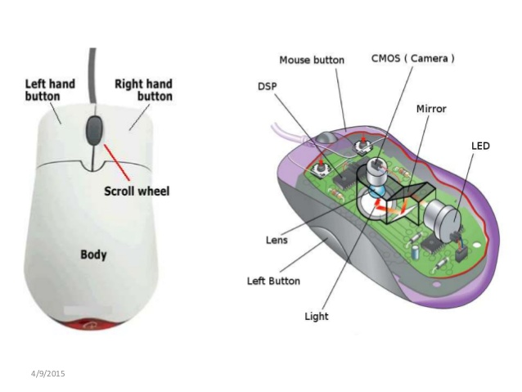
INPUT DEVICES.
Mouse:- A mouse is a handheld pointing device used to position a cursor on a computer screen. This allows the user to select items stored on a computer and, subsequently, perform actions on those items
Mechanical mouse.
Optical mouse.

Slide 10

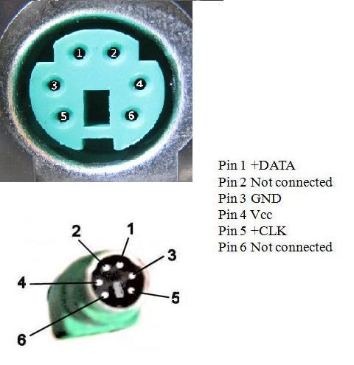
INPUT DEVICES
Mouse connector pins and details

Slide 11
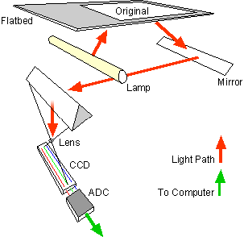
INPUT DEVICES.
A scanner is a device that captures images from photographic prints, posters, magazine pages, and similar sources for computer editing and display.
Flatbed scanner
A type of optical scanner that consists of a flat surface on which you lay documents to be scanned. Flatbed scanners are particularly effective for bound.

Slide 12
OUTPUT DEVICES
Notes:
Abhijeet More

Slide 13
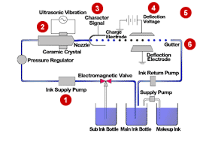
OUTPUT DEVICES
Ink Jet Printer
inkjet printer is a computer peripheral that produces hard copy by spraying ink onto paper
colour printing capacity
lower printing cost

Slide 14
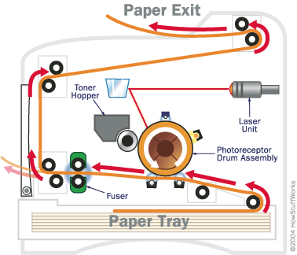
OUTPUT DEVICES
Laser Printer
Laser printing is an electrostatic digital printing process. It produces high-quality text and graphics
Laser printing is invented by Hewlett Packard in 1975

Slide 15
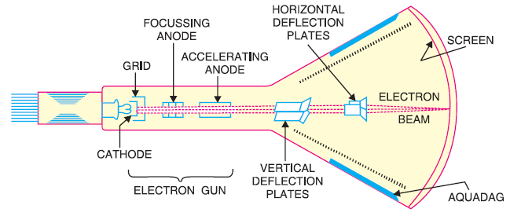
OUTPUT DEVICES
Monitor
CRT Monitor

Slide 16
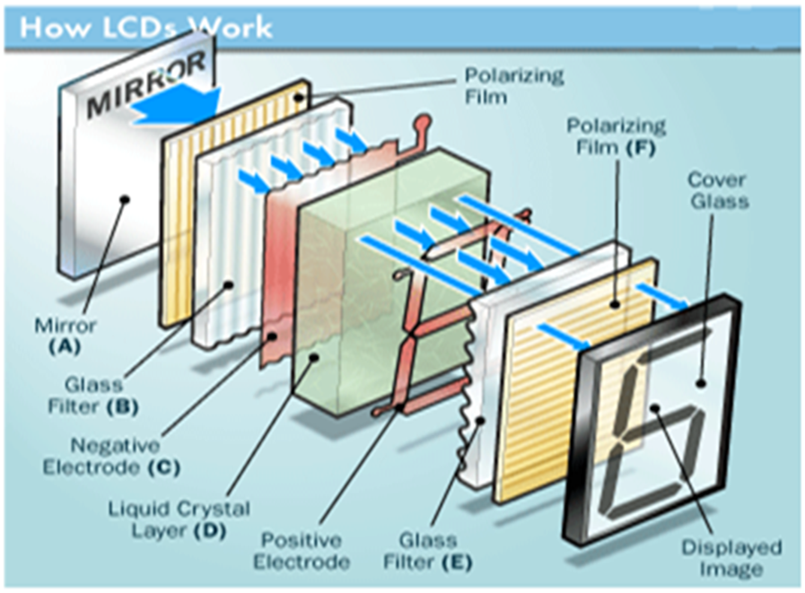
OUTPUT DEVICES
LCD Monitor
Working principle

Slide 17
Switch Mode Power Supply (SMPS)
Block Diagram of SMPS
Working Principle of SMPS
Earthing

Slide 18
Block Diagram Of SMPS
Ac I/P
230v DC I/p
Step down Transformer
Bridge Rectifier
Filter
Voltage Regulator
Feedback Circuit

Slide 19
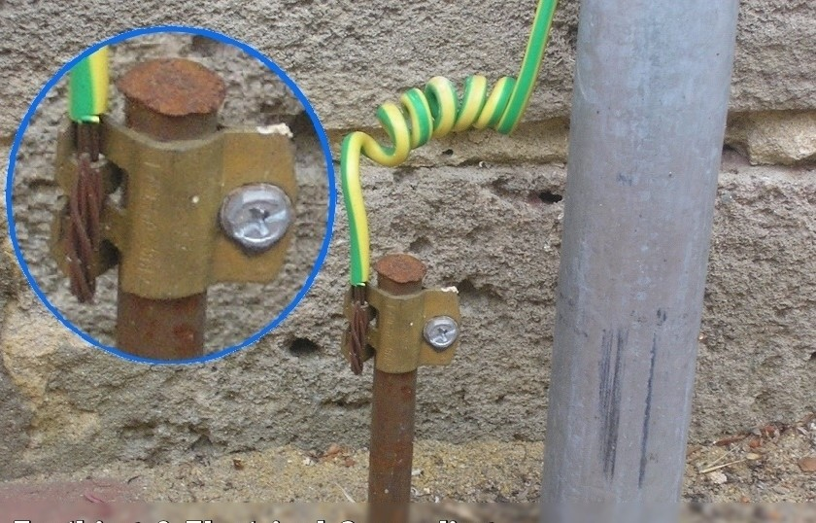
Earthing
1)What is Earthing ?

Slide 20
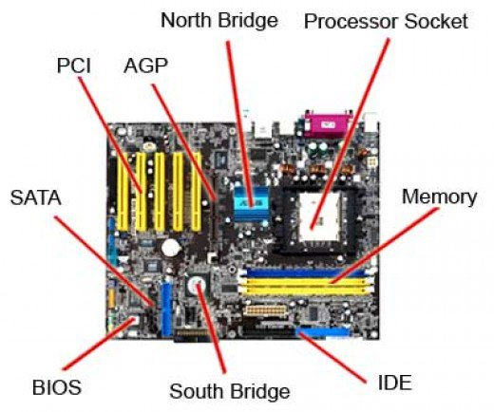
Motherboard
Other Names
Main Board
Base Board
System Board
Logic Board
Abbreviation: MBD

Slide 21
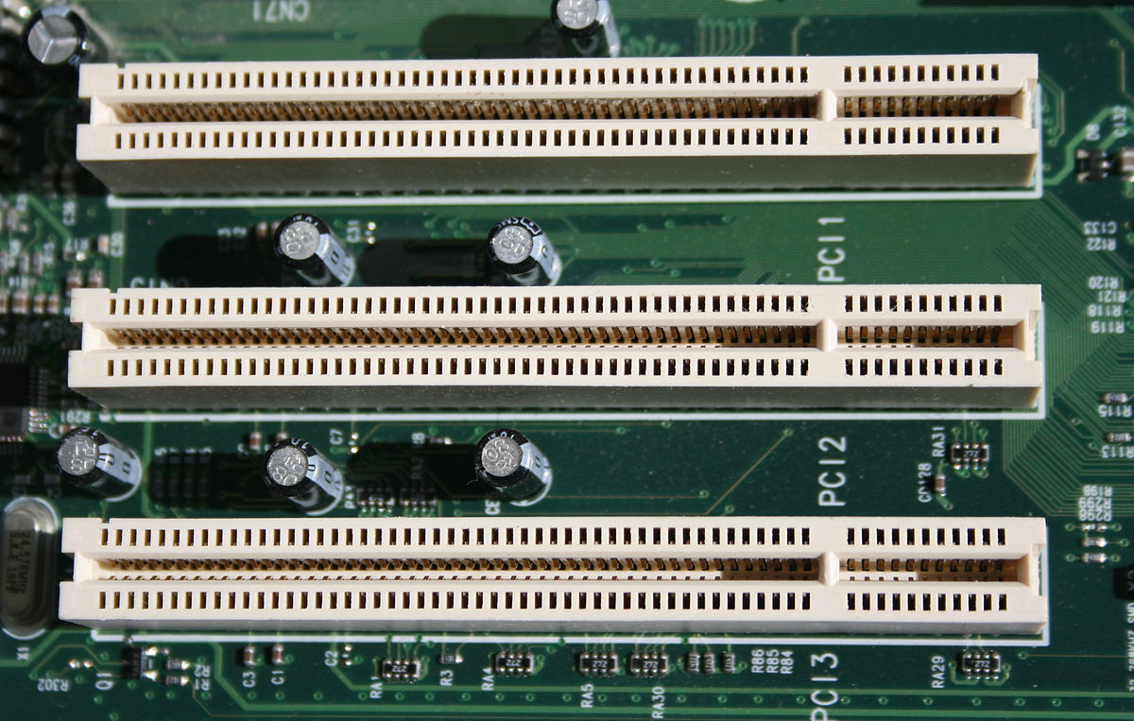
PCI Slots
Stands for Peripheral Component Interconnect
Examples:
Modem
Network Card
Video Card
Sound Card

Slide 22
MOTHERBOARD
Notes:
Abhijeet More

Slide 23

MOTHERBOARD

Slide 24
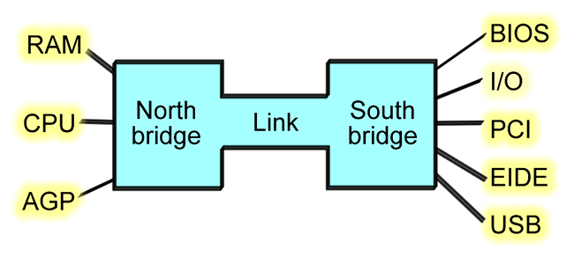
MOTHERBOARD
Key Components
Northbridge:
Also known as Memory Controller Hub (MCH).
Southbridge:
Also known as the Input/output Controller Hub (ICH)

Slide 25

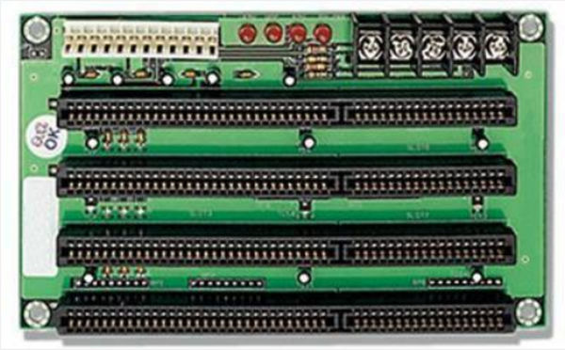
MOTHERBOARD
Connectors
PCI (Peripheral Component Interconnect)
ISA (Industry Standard Architecture)
EISA ( Extended Industry Standard Architecture)

Slide 26
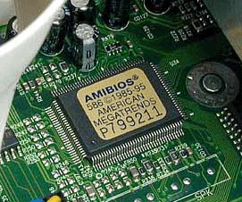
MOTHERBOARD
What is BIOS?
Working principle
BIOS setting

Slide 27
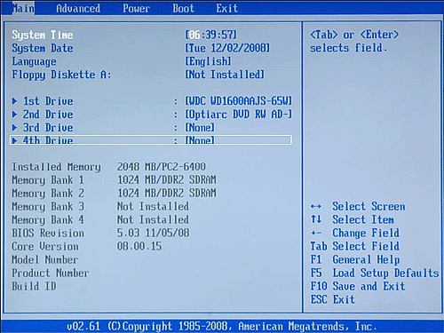
Working Principle of BIOS
POST
Bootstrap Loader
BIOS
CMOS Setup

Slide 28
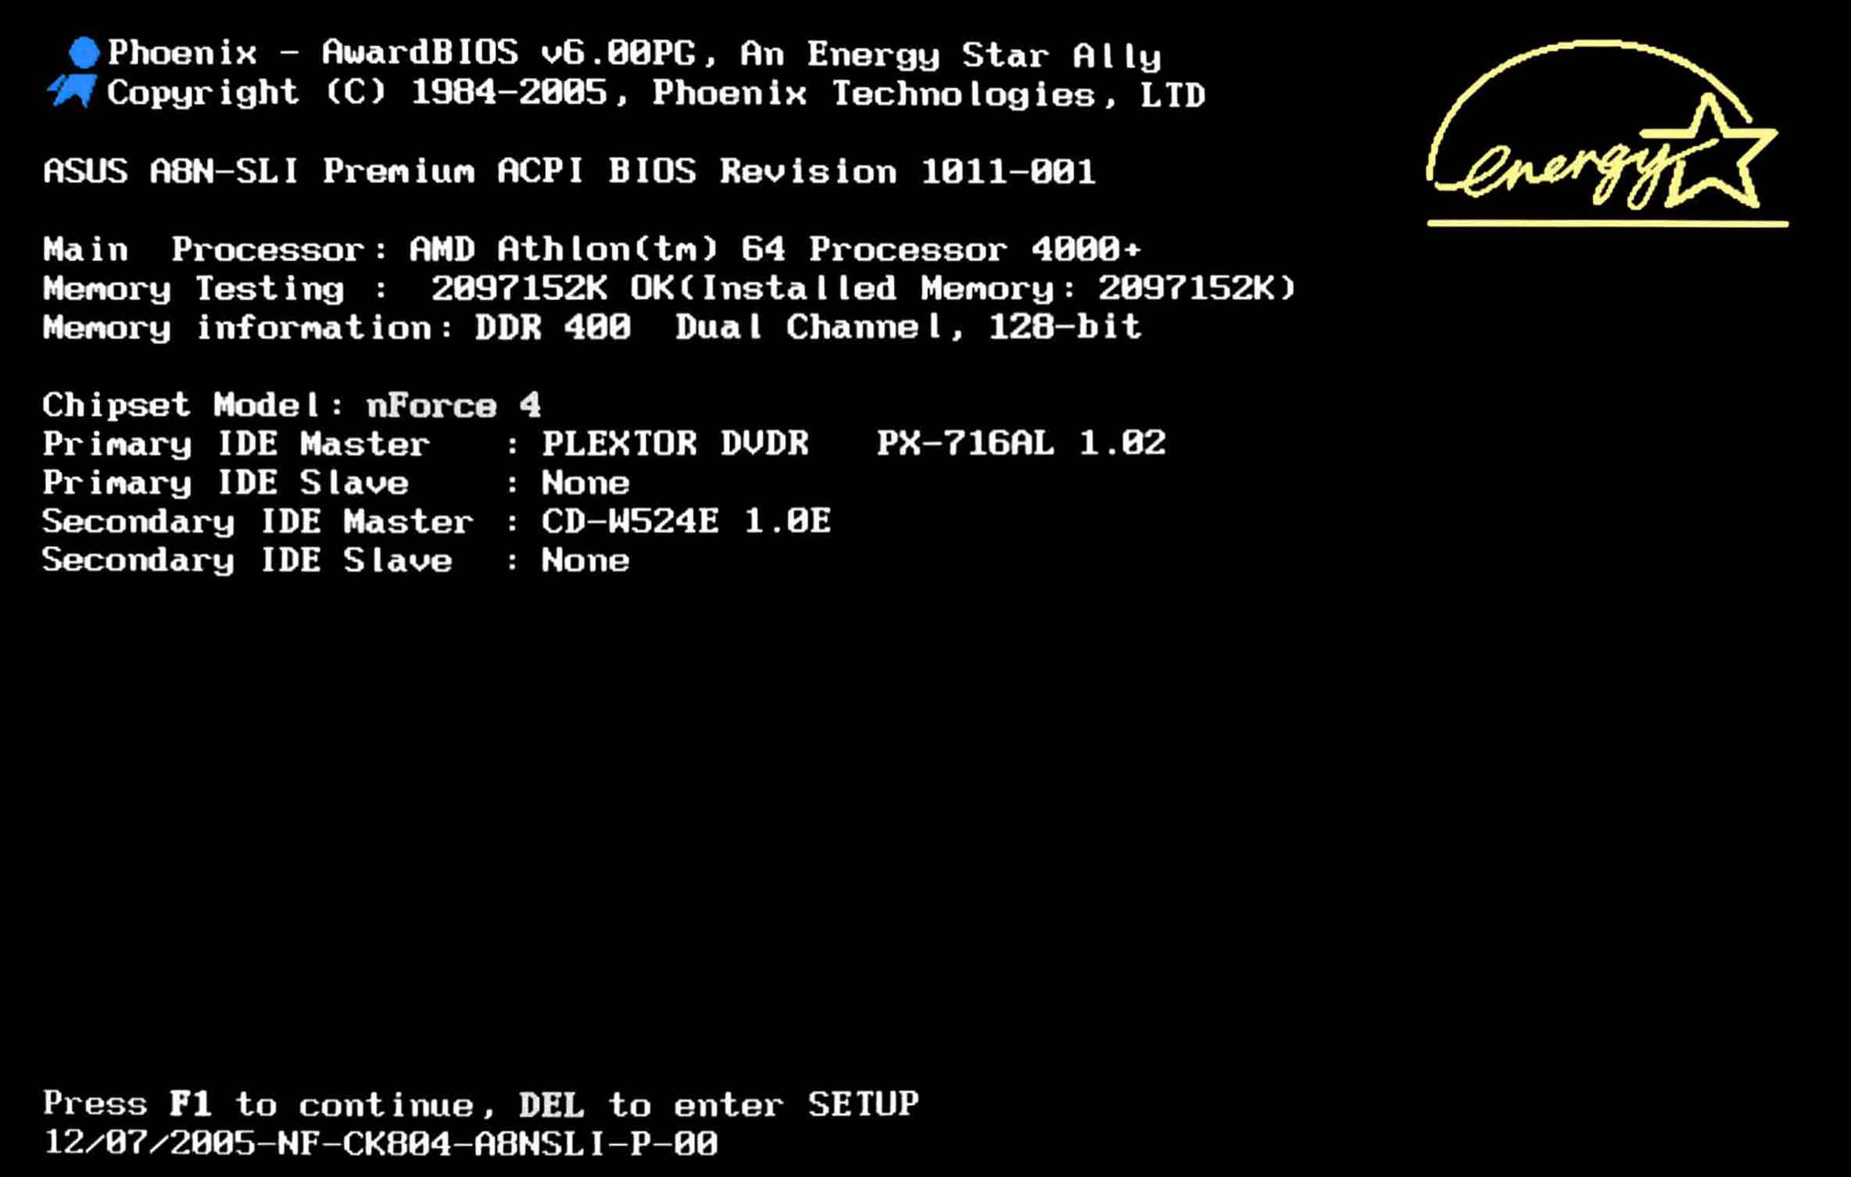
MOTHERBOARD
BIOS SETTING
F1
F2
F10
Del
Esc

Slide 29
MOTHERBOARD
MEMORY MODULES : It is a circuit board that contain DRAM integrated circuit that are installed into memory slots of motherboard.
SIMM
DIMM
SO-DIMM

Slide 30
CENTRAL PROCESSING UNIT
Notes:
Abhijeet More

Slide 31
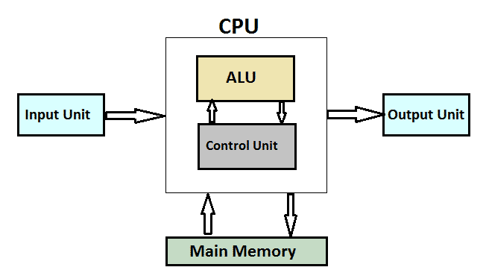
CPU
CENTRAL PROCESSING UNIT
The CPU is the brain of the computer where most calculations take place.
CPU is also referred as ‘Processor’ which performs all the tasks according to the set of instructions.

Slide 32
CPU
TYPES OF CPU ARCHITECTURE
CISC
RISC
Includes multi-clock
complex instructions
Memory-to-memory: "LOAD" and "STORE“
Small code sizes, high cycles per second
High power consumption
Less memory consumption
Single-clock,
reduced instruction only
Register to register: "LOAD" and "STORE"
Low cycles per second, large code sizes
Less power consumption
More memory consumption

Slide 33
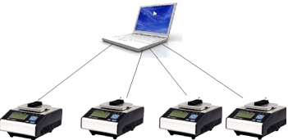
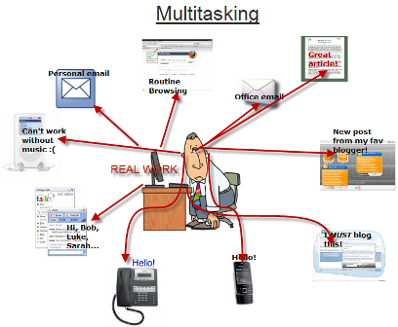
CPU
OPERATING SYSTEM CONCEPTS
Multiprogramming : To execute number of programs
Simultaneously by single processor.
Multitasking : Multiple programs running at same time and
Switching of processor resourses between multiple task
Multiprogramming

Slide 34
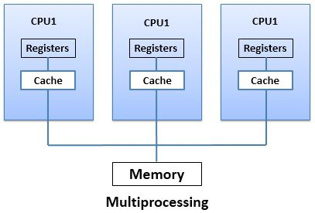
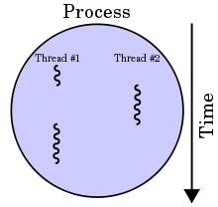
CPU
Multiprocessing : Ability to support more processors.
Multithreading : Ability of OS to execute different parts of
program simultaneously.
Multi threading

Slide 35
MEMORY
Notes:
Abhijeet More

Slide 36
MEMORY
Memory means the place where we can store data for the computer.
Types of memory
Primary Memory :- Primary memory also known as “main memory” or “internal memory” which is located in the mother board of system or directly connected to the CPU. It is the place where only little bit of data are stored either by manufacturer or by user.

Slide 37
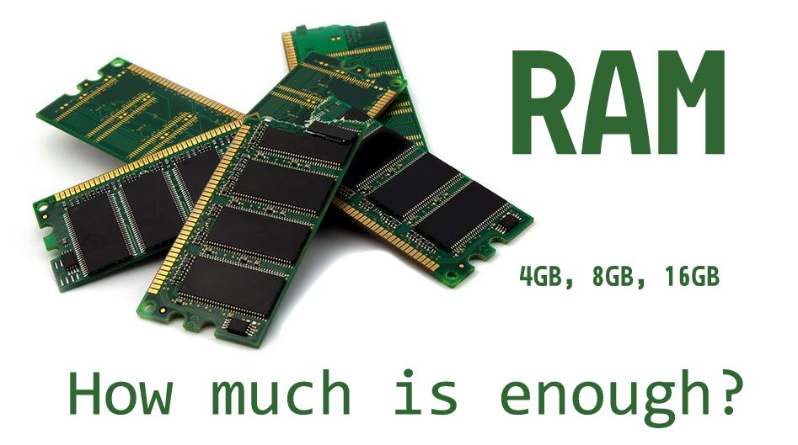
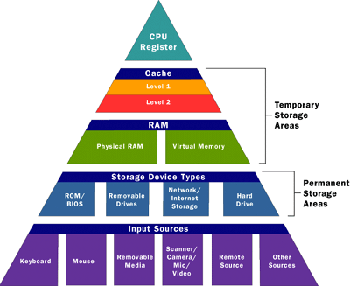
MEMORY
RAM:
RAM also known as “random access memory” it stores the data which the user currently uses or it stores the data temporarily in it.
RAM is further classified into two parts
¬ SRAM
¬ DRAM

Slide 38
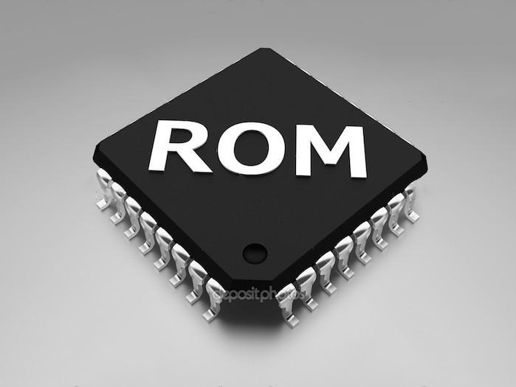
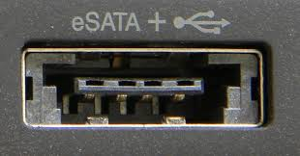
MEMORY
ROM: ROM is Known as “Read Only Memory” as the word refers mainly it can only read the data which in stored in it.
Types:
PROM
EPROM
EEPROM
SATA: SATA-Serial ATA (Serial Advanced Technology Attachment or SATA) is a standard for connecting and transferring data from hard disk drives (HDDs) to computer systems.

Slide 39
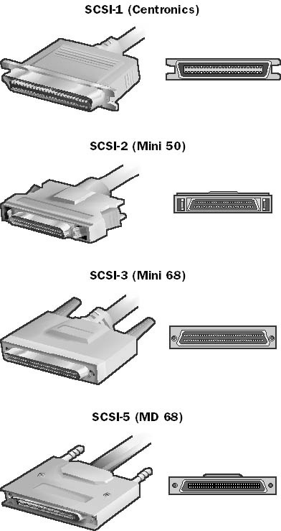
MEMORY
SCSI: The Small Computer System Interface (SCSI) is a set of parallel interface standards developed by the American National Standards Institute (ANSI) for attaching printers, disk drives, scanners and other peripherals to computers.SCSI (pronounced "skuzzy") is supported by all major operating systems.

Slide 40
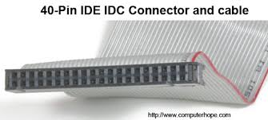
Integrated Drive Electronics
IDE (Integrated Drive Electronics) is a standard electronic interface used between a computer motherboard's data paths or bus and the computer's disk storage devices.

Slide 41
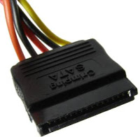
SATA Power Connector:
Below is the SATA power connector. It has 7 pins. It is only for Serial ATA drives such as SATA hard disk drives and SATA CD or DVD drives. latest SMPSs have this connector. All SMPSs have 2 SATA power connectors.

Slide 42
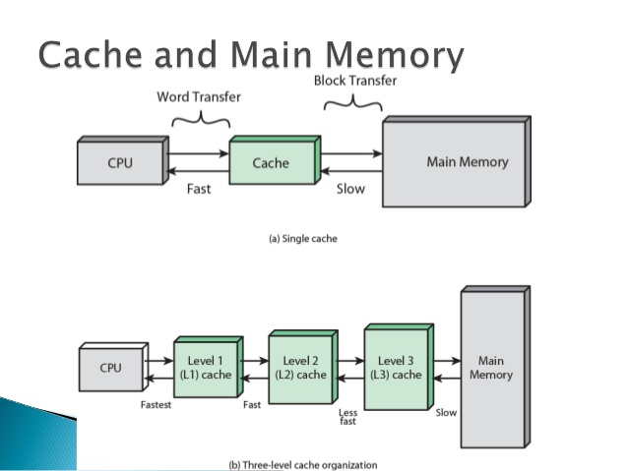
Cache Memory
A cache memory or memory cache is a fast and relatively small memory, that stores the most recently used main memory data.
It is of 3 types :
L1 Cache
L2 Cache
L3 Cache

Slide 43
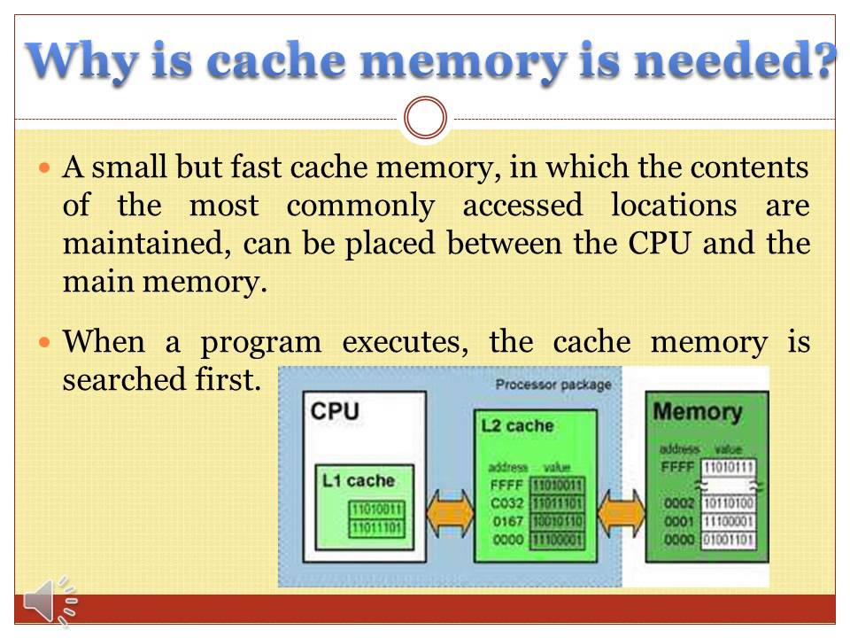
Cache Memory

Slide 44
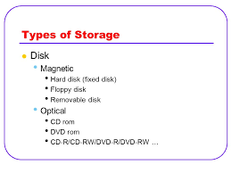
Storage
A storage device is any computing hardware that is used for storing, porting and extracting data files and objects.

Slide 45
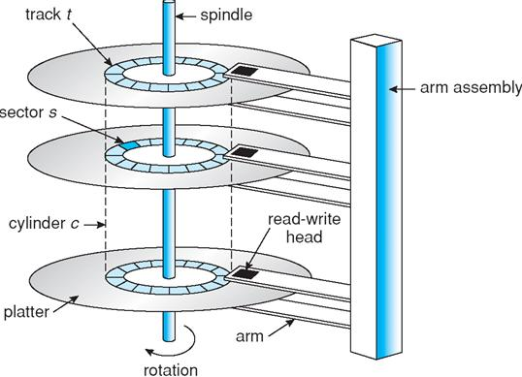
Magnetic Storage
Magnetic storage or magnetic recording is the storage of data on a magnetized medium.
Magnetic storage uses different patterns of magnetization in a magnetisable material to store data and is a form of non-volatile memory.

Slide 46
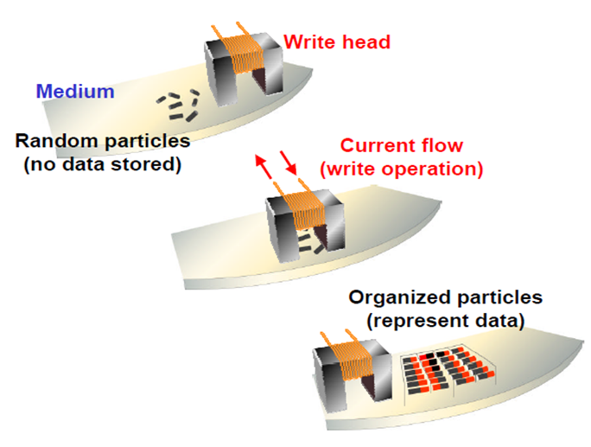
Magnetic Storage
Working of Magnetic Storage :

Slide 47
Thank you

